Slide 1
PyGame 1 – Template
Vishal Yelisetti
Python

Slide 2
PyGame Installation
Instructions
Installing Pygame · KCC Blog (kidscancode.org)
Has both Mac and Windows installation
Will need a editor (Pycharm, Notepad++, Sublime, Atom, VSCode or any other…)

Slide 3
PyGame
PyGame library that helps in creating games in python
Used to create
Animation/Graphics
Sound
Control

Slide 4
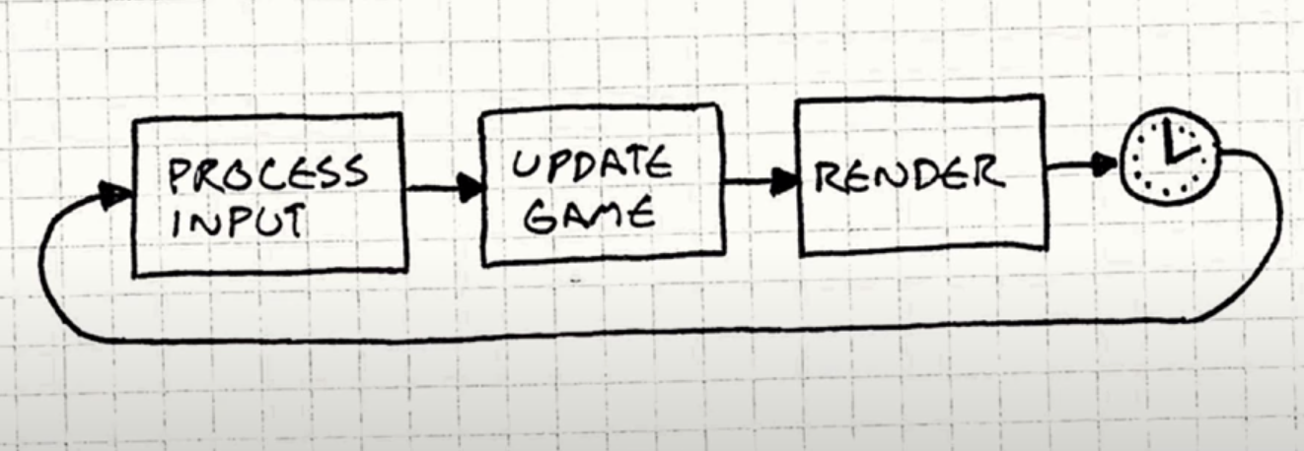
Game Loop

Slide 5
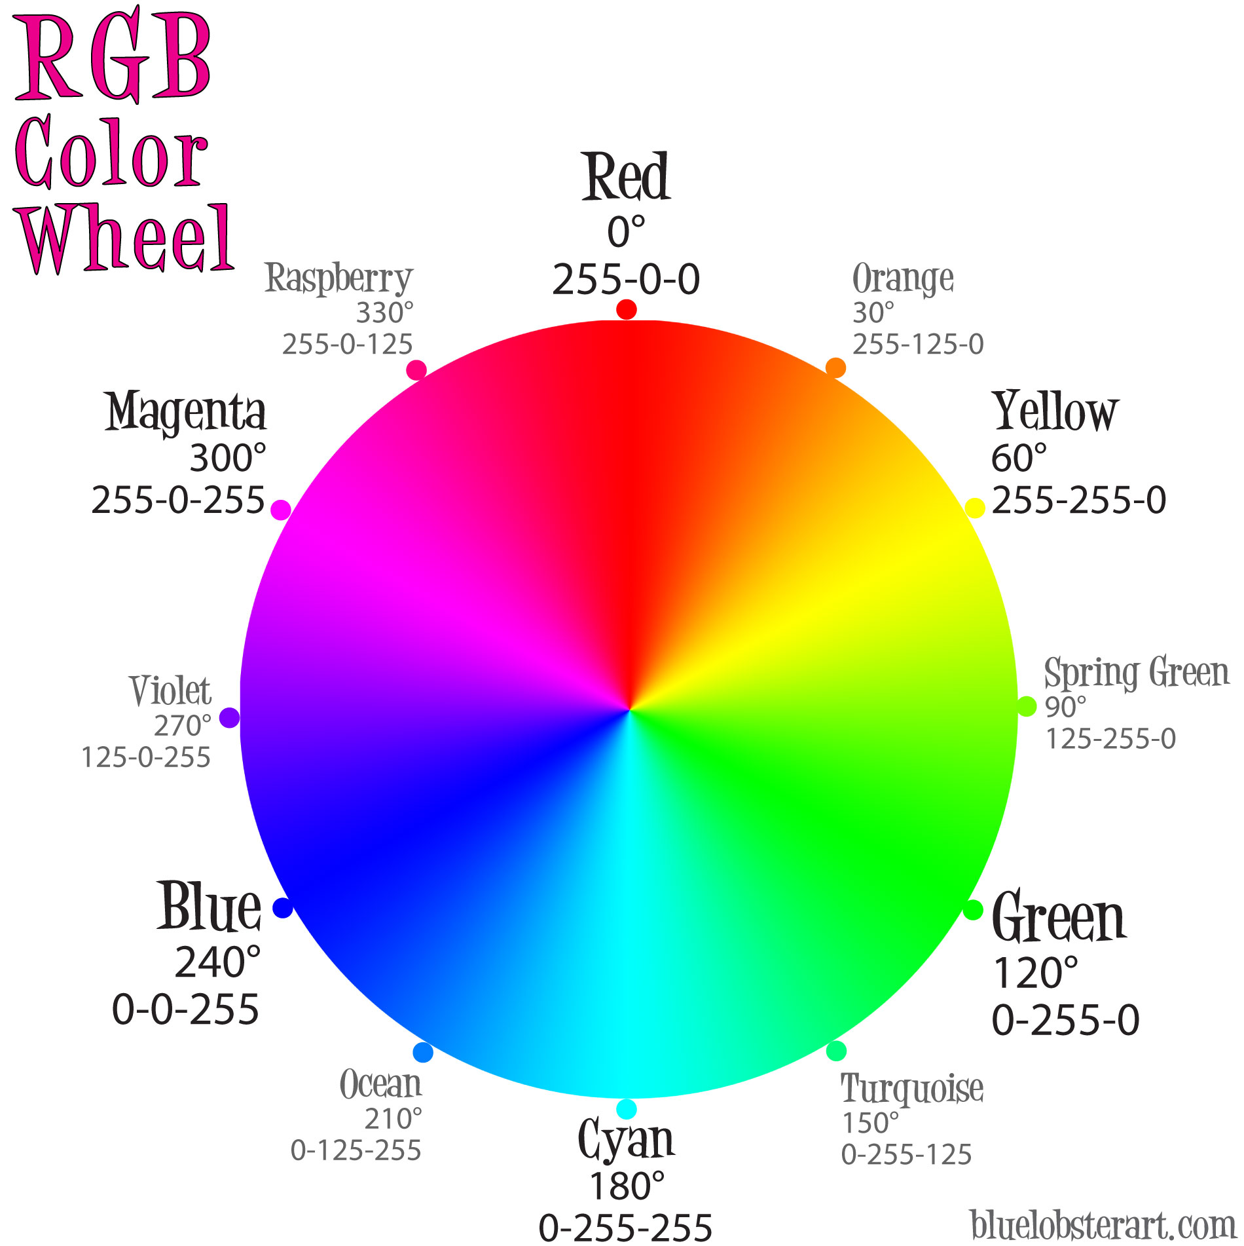
Color Wheel
https://www.webriti.com/wp-content/uploads/2012/01/rgb-color-wheel-lg.jpg

Slide 6
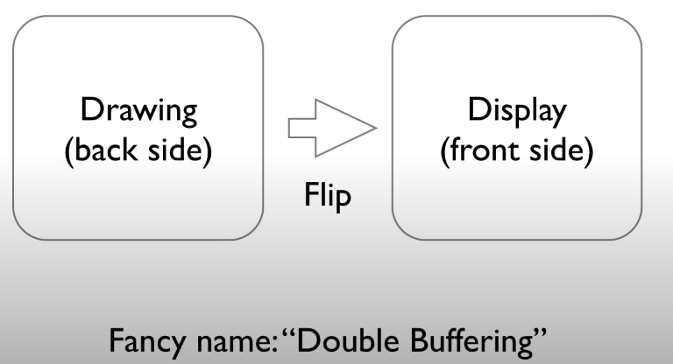
Double Buffering
Show the screen first
When the loop is running, just flip to the other side and show the new loop animation/drawing

Slide 7
Videos
Game Development 1-1: Getting Started with Pygame - YouTube

